Slide 1

AI Interview Simulator
Master your interview skills with intelligent, personalized practice anytime, anywhere

Slide 2

THE CHALLENGE
Why Students Struggle with Interviews
Limited Practice
No access to regular mock interviews or realistic scenarios
Missing Feedback
No instant, personalized evaluation to identify weaknesses
High Costs
Existing platforms are expensive or too generic for individual needs
Performance Anxiety
Nervousness without tools for real-time performance improvement

Slide 3


OUR SOLUTION
Smart Interview Practice, Powered by AI
What We Built
An intelligent web platform that simulates real interviews, evaluates your answers using AI, and delivers personalized feedback instantly
Practice HR and technical questions
Get scored with NLP and machine learning
Receive actionable improvement tips
Track progress over time
Best part? It's free, available 24/7, and adapts to your skill level

Slide 4





How the System Works
Login & Setup
Choose interview type and skill level
Questions
AI generates personalized questions
Answer
Respond via text or voice input
AI Analysis
NLP processes and evaluates response
Feedback
Get scores and improvement tips

Slide 5

STEP 1-2
Personalized Setup & Question Generation
Profile Customization
Smart Questions
Select interview type: HR, Technical, or Mixed
AI fetches relevant questions from database
Choose your domain: Java, Python, C++, and more
Adaptive difficulty: Easy → Medium → Hard
Set experience: Fresher to Intermediate
Random selection prevents repetition
Example question: "Explain object-oriented programming concepts in Java with real-world examples"

Slide 6

STEP 3-4
Answer Input & Text Processing
Multiple Input Options
NLP Pre-Processing Pipeline
Text input: Type your response directly
01
Voice input: Speak naturally with speech-to-text
Lowercasing
Answers stored securely for analysis
Standardize text format
02
Tokenization
Break into individual words
03
Stop-word Removal
Filter out common words
04
Lemmatization
Reduce words to root form

Slide 7

STEP 5-6
AI-Powered Answer Analysis
Relevance Analysis
Extracts keywords from question, ideal answer, and your response
Uses Cosine Similarity algorithm to measure relevance
Ensures you're staying on-topic and addressing the question
Communication Quality
Sentiment analysis detects confidence and positivity
Grammar checker evaluates sentence structure
Answer length assessment for completeness

Slide 8
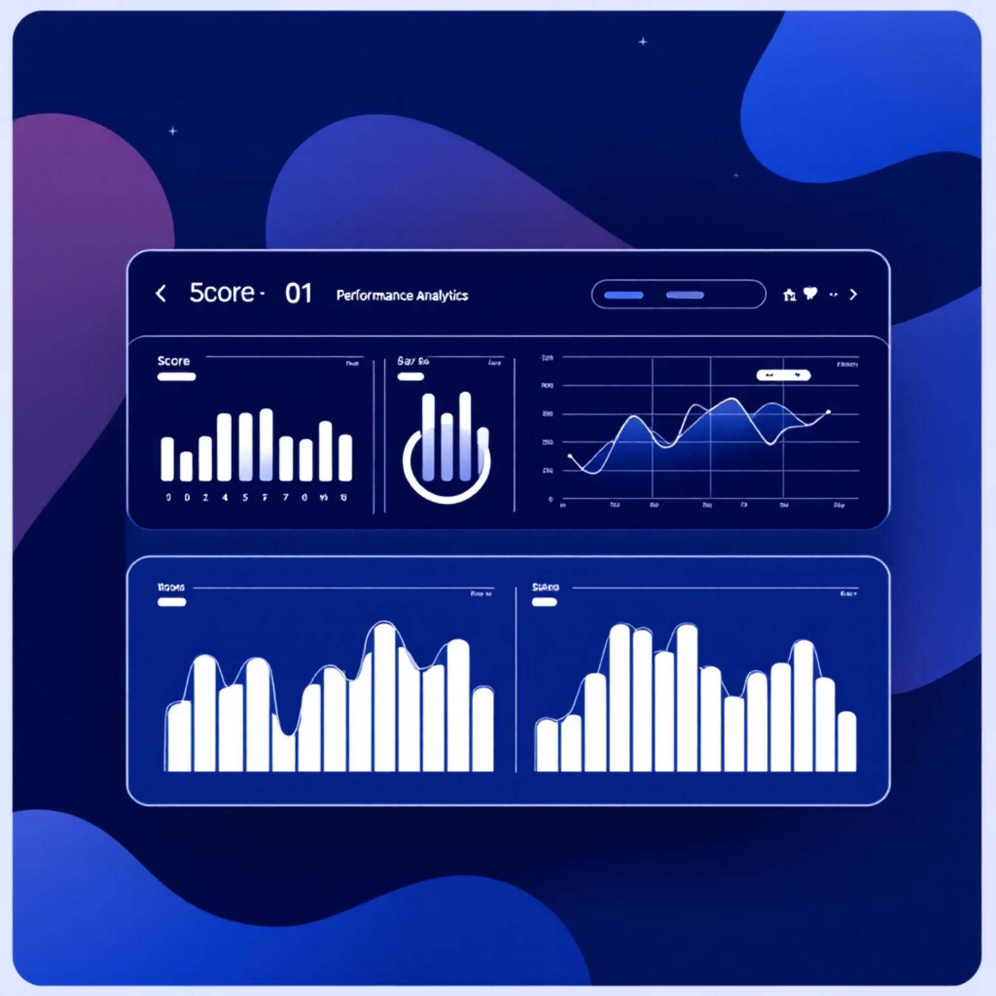
STEP 7-8
Machine Learning Evaluation & Scoring
ML Model Assessment
Comprehensive Scoring
Our trained model evaluates answer quality using multiple features:
0-10
100%
Similarity Score
How close is your answer to the ideal response?
Per Question
Final Score
Individual answer quality score
Normalized overall interview performance
Keyword Matching
Did you cover the essential concepts?
Sentiment Analysis
Is your tone confident and professional?
Grammar Quality
Are your sentences clear and well-structured?

Slide 9

Your Personalized Dashboard
Detailed Feedback
Performance Tracking
Strengths highlighted and weak areas identified with suggested improvements
Question-wise analysis with visual progress graphs over time
Sample Answers
History Saved
Access ideal responses to learn from and compare against
All sessions stored for future reference and improvement tracking

Slide 10

Built with Modern Technology
Frontend
Backend
HTML, CSS, JavaScript, React
Python with Flask framework
NLP & ML
Database
NLTK, spaCy, Scikit-learn
SQLite / MongoDB
Ready to Ace Your Next Interview?
Practice with our AI Interview Simulator and build confidence through personalized, intelligent feedback. Transform nervousness into preparedness.

